Slide 1
Homework

Slide 2
Homework requirement
Faculty has 88 Teachers
Faculty has hardcopy records for 569 Students (graduated and not graduated)
Faculty has 41 Courses in Curriculum
Faculty has several activities that students should achieve to pass the exam
Faculty has around 20000 records (Grades) for passed exams
Core requirement:
System should be able to manage Exams
Each Grade record should contain following information: Date, Student, Teacher, Course, Grade value
Additionally for each Grade, system should keep details about Achievement type (home work, exam, class activity…), achievement points, achievement maximum points and achievement date
Lets find some faculty as an example – FINKI
https://www.finki.ukim.mk/mk/dodiplomski-studii

Slide 3

SEDCHome – List of tables
Student
- ID
- FirstName
- LastName
- DateOfBirth
- EnrolledDate
- Gender
- NationalIDNumber
- StudentCardNumber
Course
- ID
- Name
- Credit
- AcademicYear
- Semester
Teacher
- ID
- FirstName
- LastName
- DateOfBirth
- AcademicRank
- HireDate
Grade
- ID
- StudentID
- CourseID
- TeacherID
- Grade
- Comment
- CreatedDate
GradeDetails
- ID
- GradeID
- AchievementTypeID
- AchievementPoints
- AchievementMaxPoints
- AchievementDate
AchievementType
- ID
- Name
- Description
- ParticipationRate

Slide 4
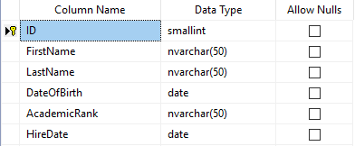
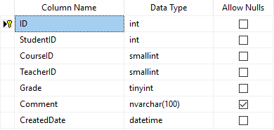
SEDCHome – Table example
Teacher
Grade

Slide 5
